Slide 1







STACK OVERFLOW DEVELOPER SURVEY 2019
Crovella, Francesco Pio
May 09th, 2022

Slide 2



OUTLINE
Executive Summary
Introduction
Methodology
Results
Visualization – Charts
Dashboard
Discussion
Findings & Implications
Conclusion
Appendix

Slide 3

EXECUTIVE SUMMARY
This survey is the most important analysis in the world about developers
It reveals developer’s favorite languages and technologies
This presentation report shows the trend as follows:
Programming Languages
Databases
Platforms
WebFrames
The aim of this analysis is to identify the current and future technological hard skills that modern developers have and want

Slide 4

INTRODUCTION
This report has been produced for coders and companies with regards to the current IT world and the related future
This results will help people identify future hard skills in the tech/digital market
Recommendations will be presented in the next slides

Slide 5

METHODOLOGY
For this analysis, a modified subset of the survey has been used. The different data analysis phase are the following:
Data Wrangling → for removing duplicates, managing missing values and normalizing data
Exploratory Data Analysis → for finding data distribution, eventual outliers and correlation
Data Visualization → for visualizing the different results and distributions
Dashboarding → for creating a dynamic web dashboard
The first three steps have been carried out by using Python language and Jupyter Notebooks
The dashboarding phase has been carried out by using IBM Cognos Dashboard Embedded (CDE)

Slide 6
RESULTS

Slide 7
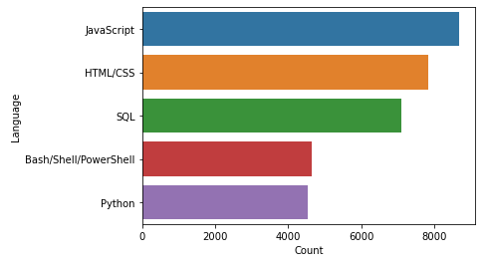
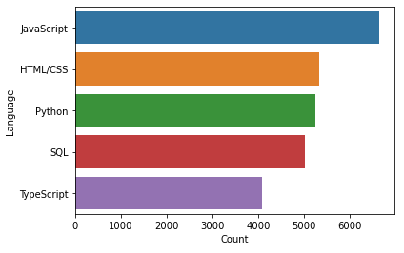
PROGRAMMING LANGUAGE TRENDS
Current Year
Next Year

Slide 8
PROGRAMMING LANGUAGE TRENDS - FINDINGS & IMPLICATIONS
Findings
Both JavaScript and HTML/CSS are the top 2 most popular languages for this year and next year
Python and TypeScript have obtained more interest for next year
Bash/Shell/PowerShell and SQL have obtained less interest for next year
Implications
Employ coders skilled in JavaScript and HTML/CSS
Employ more coders skilled in Python and TypeScript
Employ less coders skilled in SQL and Bash/Shell/PowerShell

Slide 9
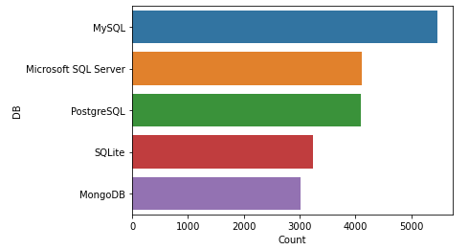
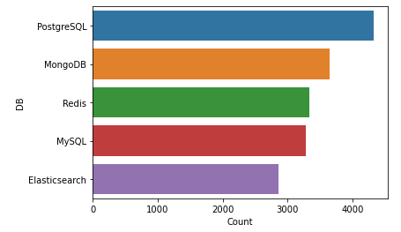
DATABASE TRENDS
Current Year
Next Year

Slide 10
DBATABASE TRENDS - FINDINGS & IMPLICATIONS
Findings
PostgreSQL and MongoDB have obtained more interest for next year
MySQL, Microsoft SQL Server and SQLite have obtained less interest for next year
Redis and Elasticsearch have obtained new interest for next year
Implications
Employ more coders skilled in PostgreSQL and MongoDB
Employ less coders skilled in MySQL, Microsoft SQL Server and SQLite
Employ more coders skilled in Redis and Elasticsearch

Slide 11

DASHBOARD
Click here for the IBM Cognos dashboard

Slide 12
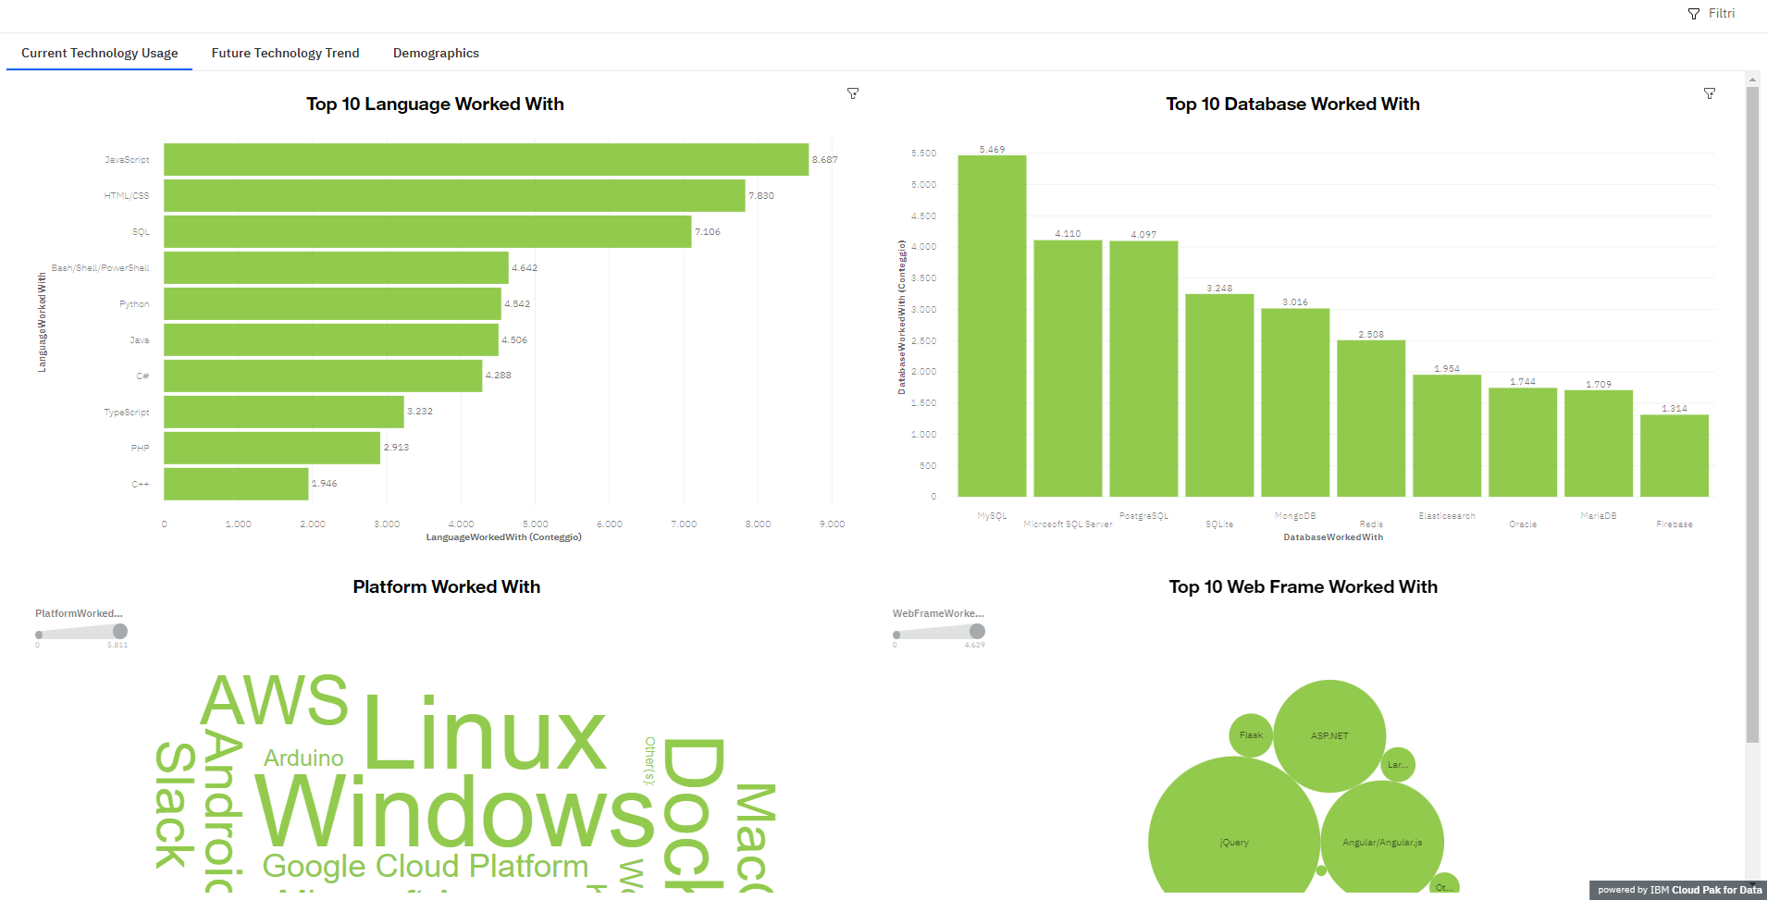
DASHBOARD TAB 1

Slide 13
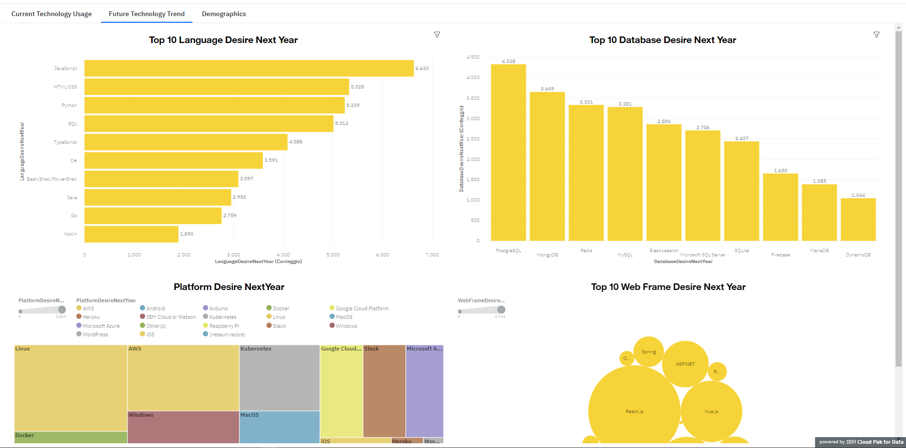
DASHBOARD TAB 2

Slide 14
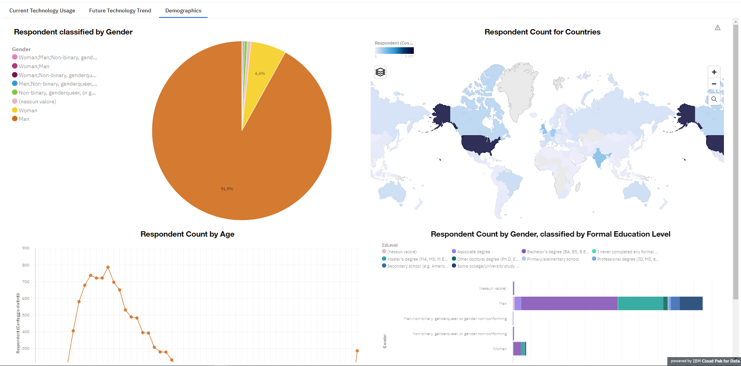
DASHBOARD TAB 3

Slide 15
DISCUSSION

Slide 16
OVERALL FINDINGS & IMPLICATIONS
Overall findings
Interest in Python language is growing
Redis, Elasticsearch, PostgreSQL and MongoDB are gaining more interest in the DBs world
Windows and Docker are the most desired platforms
React.js is the most desired web frame and Angular.js confirms the presence in the marked
Implications
Continue to employ coders skilled in JavaScript and HTML/CSS
Employ more coders skilled in Pyhton, TypeScript, Redis, Elasticsearch, PostgreSQL, MongoDB, React.js, Angular.js and Vue.js
Continue to employ coders skilled in Windows, Linux, AWS, Docker and mobile world like Android

Slide 17

CONCLUSION
Invest more in hiring new human resources skilled in the new technologies
Invest more in awareness and training about new technologies with the current human resources
Define and increase the budget for new technologies
Redefine the budget for the current year’s technologies that have no longer interest for the future

Slide 18

APPENDIX

Slide 19
GITHUB JOB POSTINGS

Slide 20
POPULAR LANGUAGES

Slide 21
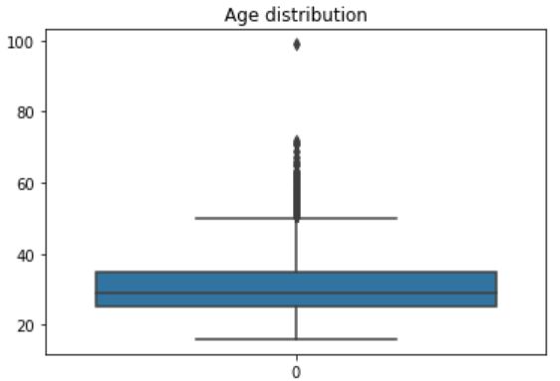
RELEVANT ADDITIONAL CHARTS
Age distribution of developers

Slide 22
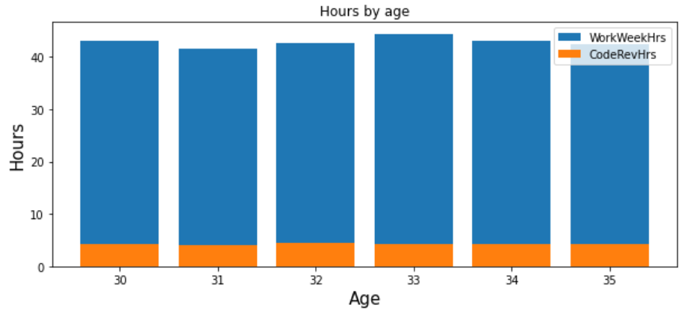
RELEVANT ADDITIONAL CHARTS
Work hours distribution by age

Slide 23
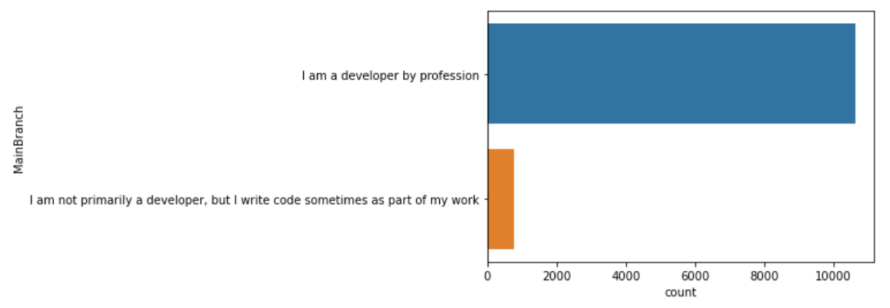
RELEVANT ADDITIONAL CHARTS
Distribution of developers

